Slide 1


Investor Presentation LD Micro Virtual NYSE American: WYY
www.widepoint.com March 3, 2020

Slide 2
Safe Harbor Statement
This presentation may contain forward-looking information within the meaning of Section 21E of the Securities Exchange Act of 1934, as amended (the Exchange Act), including all statements that are not statements of historical fact regarding the intent, belief or current expectations of the company, its directors or its officers with respect to, among other things: (i) the Company's financing plans; (ii) trends affecting the Company's financial condition or results of operations; (iii) the company's growth strategy and operating strategy; (iv) the Company's ability to achieve profitability and positive cash flows; (v) the Company's ability to raise additional capital on favorable terms or at all; (vii) the Company's ability to gain market acceptance for its products and (viii) the risk factors disclosed in the Company's periodic reports filed with the SEC. The words "may," "would," "will," "expect," "estimate," "anticipate," "believe," "intend" and similar expressions and variations thereof are intended to identify forward-looking statements. Investors are cautioned that any such forward-looking statements are not guarantees of future performance and involve risks and uncertainties, many of which are beyond the company's ability to control, and that actual results may differ materially from those projected in the forward-looking statements as a result of various factors including the risk factors disclosed in the Company's Annual Report on Form 10-K for the year ended December 31, 2017 filed with the SEC on March 21, 2018.

Slide 3
About WidePoint (NYSE American: WYY)
WidePoint converges Telecom Lifecycle Management, Identity Management and Mobility Management into a unified platform called
Trusted Mobility Management (TM2)
Challenge:
Managing the mobile environment is complex and time-consuming
Organizations must review, procure and integrate numerous applications and technologies
Solution:
TM2 enables organizations to secure, manage and analyze mobile resources and investment to maximize the benefits of mobility
$39M Market Cap. (Feb. 28, 2020)
1997
Established
2019 Guidance
Revenues: $95M
Adj. EBIDTA: $3.5M
2017
New management appointed & strategy implemented
Nine consecutive quarters of adj. EBITDA profitability (Q3’17 – Q3’19)
GAAP net income first nine months of 2019
287
Employees
No Debt
Headquarters: Fairfax, Virginia
Regional Offices: Columbus, Ohio / Hampton, Virginia /
Dublin, Ireland

Slide 4


The Mobile Environment is Expanding
By 2020:
31.1 billion
Internet of Things (IoT) connected devices
2 Zettabytes
of global traffic per year ¹
Increasing number
of devices → Larger
attack surface
44 Zettabytes
of total accumulated data²
1 - https://www.livescience.com/54094-how-big-is-the-internet.html
2 - https://www.forbes.com/sites/bernardmarr/2015/09/30/big-data-20-mind-boggling-facts-everyone-must-read/#40ce3e5917b1

Slide 5















As the Mobile Landscape Grows, Data Breaches are Increasing in Frequency & Cost
Annual number of US data breaches (in millions)¹
Average organizational cost to a US business after a data breach (in million U.S. dollars)²
1 - https://www.statista.com/statistics/273550/data-breaches-recorded-in-the-united-states-by-number-of-breaches-and-records-exposed/
2 - https://www.statista.com/statistics/273575/average-organizational-cost-incurred-by-a-data-breach/

Slide 6
Product Overview
Trusted Mobility Management (TM2) - Full Solutions Suite
MANAGEMENT Telecom Lifecycle Management (TLM)
SECURITY
Identity Management (IdM)
VISIBILITY
Telecom Digital Billing & Analytics

Slide 7





Telecom Lifecycle Management (TLM)
WidePoint – the leading TLM provider to the U.S. public sector
Manages all aspects of an enterprise’s telecom assets and services (e.g., landlines, mobile, IoT devices, etc.)
Customized, flexible implementation
Delivered using a managed services model
Enhanced security
Supported by subject matter experts
Entrusted by 100+ global enterprises

Slide 8
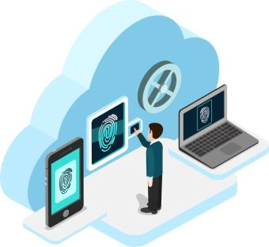




Identity Management (IdM)
Allows enterprises to identify & grant/deny access to individual users
Eliminates the need for multiple ID & password combinations
Federal/military grade IdM solution
Certified & fully compliant with Federal mandates
Secure Digital ID - Certificate on device (COD)
Public/private key encryption
Physical & logical access
Credentialing, enrollment & issuance, infrastructure support
Relied on by 18,000+ enterprises

Slide 9

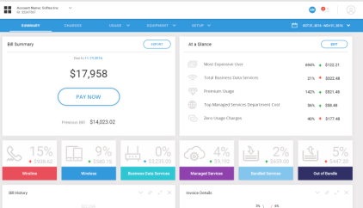







Digital Billing & Analytics
Cloud-based platform provides Communications Service Providers (CSPs) full visibility into their revenue model
Consolidates all invoice information:
Bill presentment, subscriber data, voice analytics, bill auditing & dispute resolution, cost allocation, expense optimization
Advanced data analytics (e.g., seasonality, under/over usage)
Enhances customer experience, reduces operating costs, improves profitability
Used by these companies

Slide 10
























Diversified & Expanding Customer Base
FEDERAL GOVERNMENT
COMMERCIAL & “SLED”

Slide 11

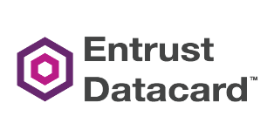




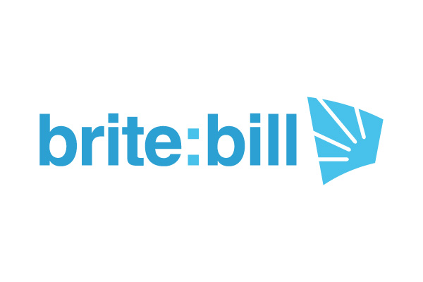




Competitive Landscape
Telecom Lifecycle Management
Identity Management
Digital Billing & Analytics

Slide 12
Why We Win
Subject Matter Experts in Trusted Mobility Management
20-year relationship with U.S. Federal Government and the only TLM solution to receive multiple ATOs from the federal government
The only TLM provider that also addresses the full spectrum of mobile security management with Identity Management solutions
Proprietary and proven cloud-based solutions that can be tailored to and scale with customer needs
Excellent past performance and client retention

Slide 13







Building Customer Momentum
Aug. 2018
$12M+ Order
Oct. 2018
$20M+ Contract
Feb. 2019
$10M+ Revenue
July 2019
$6M Contract
Q3 2019
$14.7M Awards
$12M+ order from the U.S. Coast Guard to deliver enterprise-wide wireless Mobile Communications Management Services
Received contract awards from multiple government agencies, which added c. $20M in revenues from September 2018 through November 2019
WidePoint partnered with Leidos to win NASA’s End-User Services & Technologies (NEST) contract award
WidePoint Subsidiary Soft-ex awarded $6M contract renewal with Global Communications Service Provider (CSP)
Received $14.7M in contract awards during Q3 2019 for Telecom Expense Management (TEM) and Mobility Managed Services (MMS)

Slide 14
Compliance is Key
Proprietary Management Platform, ITMS™ – certified & government compliant
Successful implementation of ITMS™ instance in AWS GovCloud for Census 2020 Decennial Device as a Service (dDaaS) contract. FedRAMP High Impact Level environment.
Authorization to Operate (ATO) from the U.S. Department of Homeland Security (DHS) Headquarters for WidePoint-hosted ITMS™
Migrating to AWS FedRAMP Cloud (US) in pursuit of FedRAMP certification
Meets Federal Information Security Management Act (FISMA) at the Moderate Impact level
Includes 159 different security controls; unrivaled level of data security
Certified as Section 508 Compliant by the U.S. Customs and Border Protection (CBP)
SSAE No. 18 SOC 1 Type II Compliant per the American Institute of Certified Public Accountants (AICPA)
Public Key Infrastructure (PKI) enabled (DoD Common Access Card [CAC] equivalent)
Development Team holds active Federal Government security clearances

Slide 15
Financial Performance
> Annual Revenues ($M)
$95.0
Streamlined infrastructure and optimized cost structure
Nine quarters of positive adj. EBITDA
Net income in 1st nine months of 2019
No long-term debt
2019 Guidance:
Revenues: $95.0M
Adj. EBITDA: $3.5M
> Annual Adj. EBITDA ($M)
$3.5

Slide 16
Quarterly Financial Performance
> Revenue ($M)
> Adj. EBITDA ($M)

Slide 17

Growth Strategy
1
Develop a steady pipeline of federal & commercial enterprise opportunities
Enhance our proprietary platform & develop next-gen products to remain an industry leader
Continue to push into commercial space to diversify revenue base and expand margins
Partner with leading system integrators on large enterprise opportunities
Pursue accretive and strategic acquisitions to expand solutions (vertical) and customer base (horizontal)
2
3
4
5

Slide 18





Investment Highlights
Increasing demand for secure mobile management & identity solutions
31.1B Internet-connected devices by 2020
Improving financial performance
Positive outlook for topline growth and profitability
Proprietary & scalable solution
The only, all-encompassing solution on the market trusted by major Federal agencies and Fortune 500 companies
Proven management team executing on growth strategy
Executed turnaround strategy and positioned company on path for profitable growth
Diversified & expanding customer base
Building momentum with new and existing customers - $14.7M in recent contract awards

Slide 19
Fourth Quarter and Full Year 2019 Earnings Call Tuesday, March 24, 2020 4:30 p.m. ET (1:30 p.m. PT)
Upcoming Events

Slide 20

Contact Us
WidePoint Corporate Headquarters 11250 Waples Mill Road
South Tower, Suite 210
Fairfax, VA 22030 (703) 349-5644
Matt Glover and Charlie Schumacher Gateway Investor Relations (949) 574-3860 WYY@gatewayir.com

Slide 21
Appendix

Slide 22
Leadership Team
Jin Kang / President and Chief Executive Officer
Kang is President and Chief Executive Officer of WidePoint Corporation and serves as a Director of the Company. Kang was the founder of WidePoint Integrated Solutions Corp. (formerly known as iSYS, LLC), which he started in 1999 and served as its President and CEO until 2017. Kang successfully managed the subsidiary from inception to a company with gross revenues of $24 million when it was acquired by WidePoint in 2008.
Kang has more than 30 years of professional experience in M&A, corporate management, technology management, business development, and financial management. He is a recognized expert in the field of trusted mobility management (TM2) for both the public and private sectors. Kang held senior management positions with several of the world’s leading technology corporations and high-profile government programs, including the Combined DNA Index System (CODIS), Defense Medical Information Systems/Systems Integration, Design Development, Operations and Maintenance Services (D/SIDDOMS), and the Defense Blood Standard System (DBSS).
Kang received his Bachelor’s and Master’s degrees in Computer Science and Computer Systems Management from the University of Maryland.
Jason Holloway / EVP, Chief Sales & Marketing Officer and CEO and President of WidePoint Cybersecurity Solutions Corporation
Holloway has been in the IT industry for more than 25 years, holding senior executive positions in multiple IT organizations, with a primary focus on business development, sales, and management to profitability. Holloway co-founded Nexcentri, an IT provider for the Credit Union industry, in 2001 and served as president and CEO until 2013. Prior to Nexcentri, he was president and CEO of Networked Knowledge Systems (NKS), a global Linux security managed service company where he increased annual revenue more than 800% in five years, servicing clients such as IBM and PwC, and making NKS an Open Source Managed Security industry leader.
Kellie Kim / WidePoint Chief Financial Officer
Kim was appointed as the Company’s Chief Financial Officer on January 2, 2020. Ms. Kim has more than 30 years of experience supporting both public and private companies that operate in a variety of industries, including telecom, technology, and professional services with government practice. Ms. Kim has helped organizations through their transformation and reorganization, implementing best practices, streamlining their technology and/or process and procedures, and updating business systems or scaling organically or through acquisitions. Most recently Ms. Kim served as the Principal of Clarius Consultants LLC, a consulting firm providing outsourced CFO services that was founded by Ms. Kim. Prior to that time, she served as the CFO of various companies, including CFO of Witt O’Brien’s LLC, a wholly-owned subsidiary of Seacor Holdings, CFO of Opus Group, LLC and CFO of Astrium Services Government, Inc., a subsidiary of Airbus Defense & Space.
Kim is a Certified Public Accountant and has a Bachelor of Science in Accounting from the University of Maryland.

Slide 23

TLM Case Study U.S. Army Corps of Engineers (USACE)
Challenge:
USACE’s telecom assets managed by large integrator
Distribution → Disorganization
No way to track devices or analyze data
The solution needed to:
Establish an enterprise-wide inventory for USACE’s 28,000 lines
Provide a centralized order updating and processing system.
Provide visibility and invoice validation
Optimize spend based upon actual usage
Solution:
WidePoint’s TLM solution consolidates all accounts onto one platform providing real-time visibility
Results:
$33 million in savings realized since February 2011
Monthly wireless expenses reduced by 49%
200%+ ROI
In January 2018, USACE awarded WidePoint a new contract valued at more than $4.3 million

